Slide 1
Project management
Chapter 5 of Ian Sommerville’s Software Engineering

Slide 2
Objectives
To explain the main tasks undertaken by project managers
To introduce software project management and to describe its distinctive characteristics
To discuss project planning and the planning process
To show how graphical schedule representations are used by project management
To discuss the notion of risks and the risk management process

Slide 3
Topics covered
Management activities
Project planning
Project scheduling
Risk management

Slide 4
Software project management
Concerned with activities involved in ensuring
that software is delivered on time and on
schedule and in accordance with the
requirements of the organisations developing
and procuring the software.
Project management is needed because software development is always subject to budget and schedule constraints that are set by the organisation developing the software.

Slide 5
Software management distinctions
The product is intangible.
The product is uniquely flexible.
Software engineering is not recognized as an
engineering discipline with the same status as mechanical, electrical engineering, etc.
The software development process is not
standardised.
Many software projects are 'one-off' projects.

Slide 6
Management activities
Proposal writing.
Project planning and scheduling.
Project costing.
Project monitoring and reviews.
Personnel selection and evaluation.
Report writing and presentations.

Slide 7
Management commonalities
These activities are not peculiar to software
management.
Many techniques of engineering project
management are equally applicable to software project management.
Technically complex engineering systems tend to suffer from the same problems as software systems.

Slide 8
Project staffing
May not be possible to appoint the ideal people to work on a project
  Project budget may not allow for the use of highly-paid staff;
  Staff with the appropriate experience may not be available;
  An organisation may wish to develop employee skills on a software project.
Managers have to work within these constraints especially when there are shortages of trained staff.

Slide 9
Project planning
Probably the most time-consuming project management activity.
Continuous activity from initial concept through
to system delivery. Plans must be regularly revised as new information becomes available.
Various different types of plan may be developed to support the main software project plan that is concerned with schedule and budget.

Slide 10
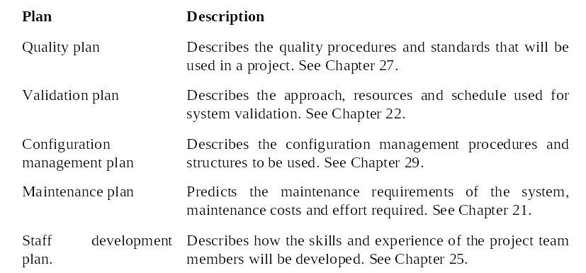
Types of project plan

Slide 11
Project planning process
Establish the project constraints
Make initial assessments of the project parameters
Define project milestones and deliverables
while project has not been completed or cancelled loop
Draw up project schedule
Initiate activities according to schedule
Wait ( for a while )
Review project progress
Revise estimates of project parameters
Update the project schedule
Re-negotiate project constraints and deliverables
if ( problems arise ) then
Initiate technical review and possible revision
end if
end loop

Slide 12
The project plan
The project plan sets out:
  The resources available to the project;
  The work breakdown;
  A schedule for the work.

Slide 13
Project plan structure
Introduction.
Project organisation.
Risk analysis.
Hardware and software resource requirements.
Work breakdown.
Project schedule.
Monitoring and reporting mechanisms.

Slide 14
Activity organization
Activities in a project should be organised to produce tangible outputs for management to judge progress.
Milestones are the end-point of a process activity.
Deliverables are project results delivered to customers.
The waterfall process allows for the straightforward definition of progress milestones.

Slide 15
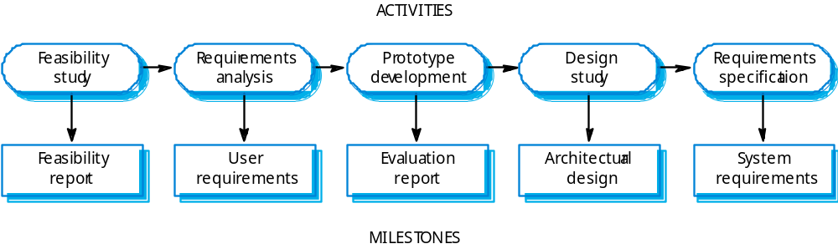
Milestones in the RE process

Slide 16
Project scheduling
Split project into tasks and estimate time and resources required to complete each task.
Organize tasks concurrently to make optimal
use of workforce.
Minimize task dependencies to avoid delays
caused by one task waiting for another to complete.
Dependent on project managers intuition and experience.

Slide 17
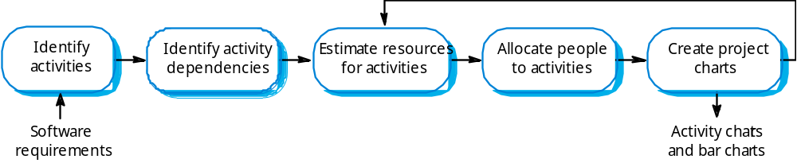
The project scheduling process

Slide 18
Scheduling problems
Estimating the difficulty of problems and hence the cost of developing a solution is hard.
Productivity is not proportional to the number of people working on a task.
Adding people to a late project makes it later because of communication overheads.
The unexpected always happens. Always allow contingency in planning.

Slide 19
Bar charts and activity networks
Graphical notations used to illustrate the project schedule.
Show project breakdown into tasks. Tasks should not be too small. They should take about a week or two.
Activity charts show task dependencies and the critical path.
Bar charts show schedule against calendar time.

Slide 20

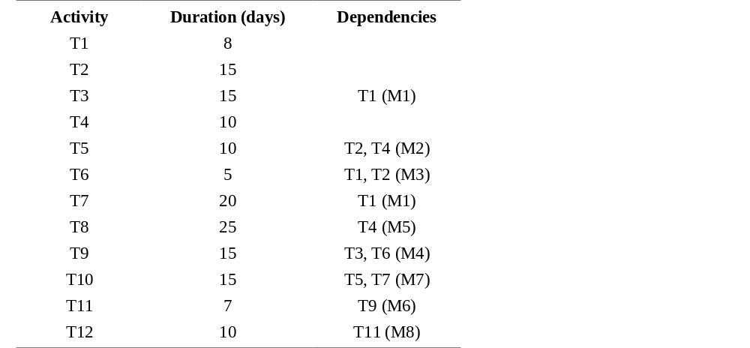
Task durations and dependencies

Slide 21

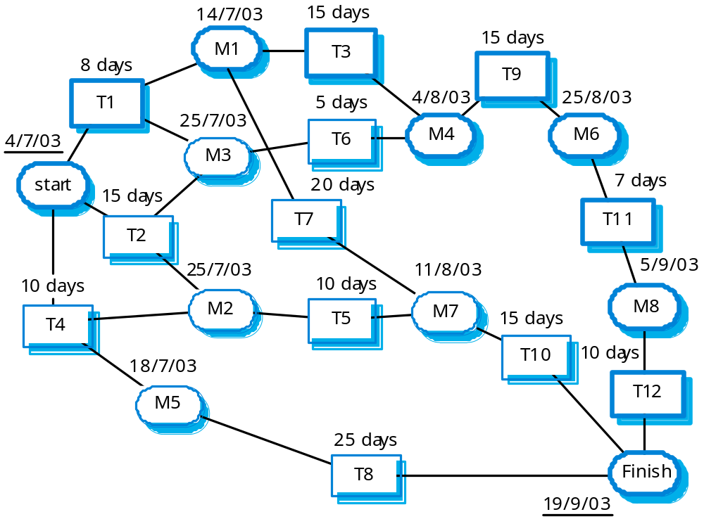
Activity network

Slide 22

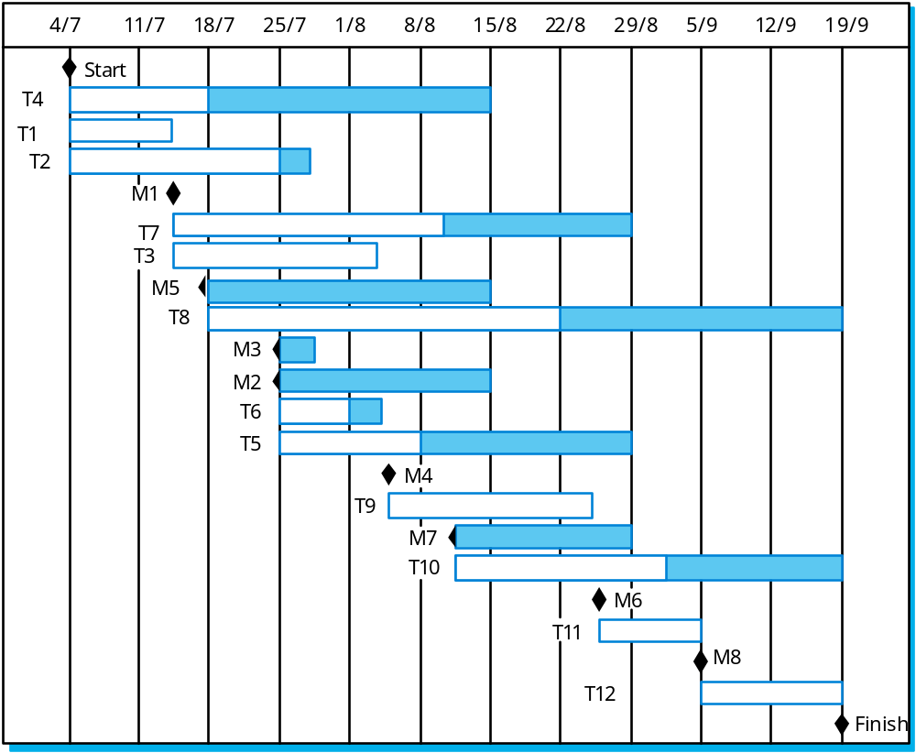
Activity timeline

Slide 23

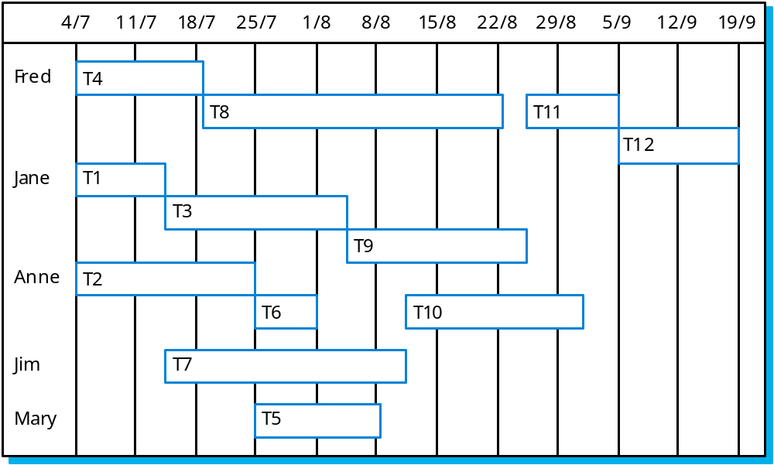
Staff allocation

Slide 24
Risk management
Risk management is concerned with identifying risks and drawing up plans to minimise their effect on a project.
A risk is a probability that some adverse circumstance will occur
  Project risks affect schedule or resources;
  Product risks affect the quality or performance of the software being developed;
  Business risks affect the organisation developing or procuring the software.

Slide 25
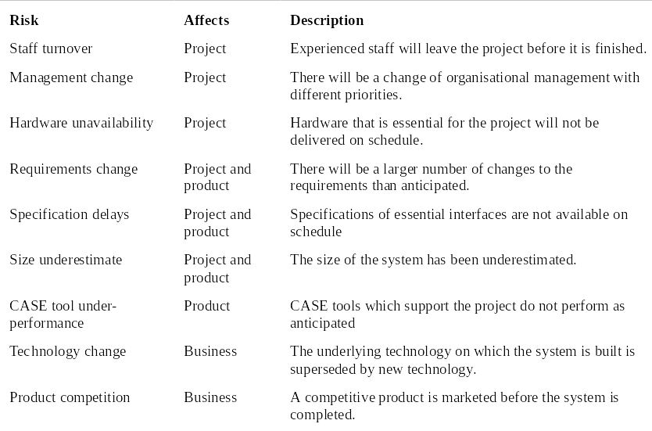
Software risks

Slide 26
The risk management process
Risk identification
  Identify project, product and business risks;
Risk analysis
  Assess the likelihood and consequences of these risks;
Risk planning
  Draw up plans to avoid or minimise the effects of the risk;
Risk monitoring
  Monitor the risks throughout the project;

Slide 27
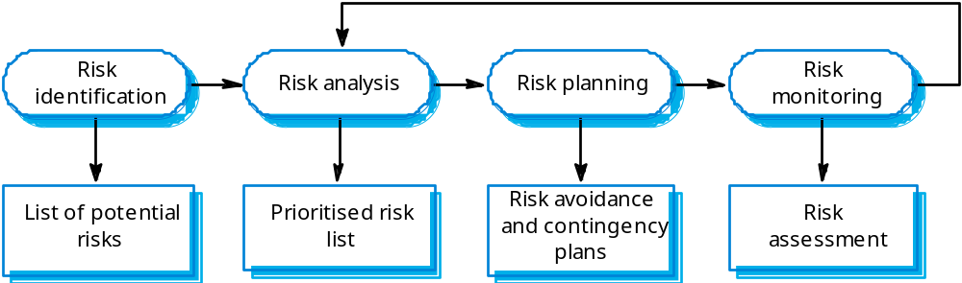
The risk management process

Slide 28
Risk identification
Technology risks.
People risks.
Organisational risks.
Requirements risks.
Estimation risks.

Slide 29
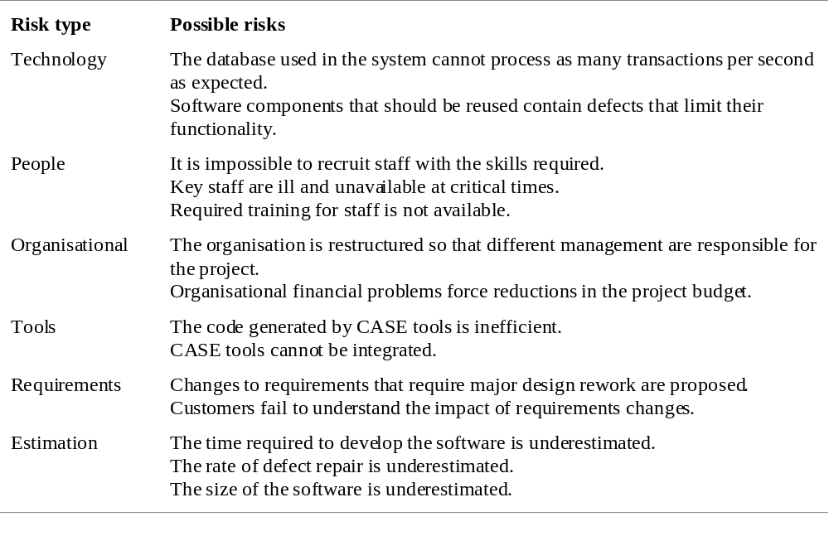
Risks and risk types

Slide 30
Risk analysis
Assess probability and seriousness of each risk.
Probability may be very low, low, moderate, high or very high.
Risk effects might be catastrophic, serious, tolerable or insignificant.

Slide 31
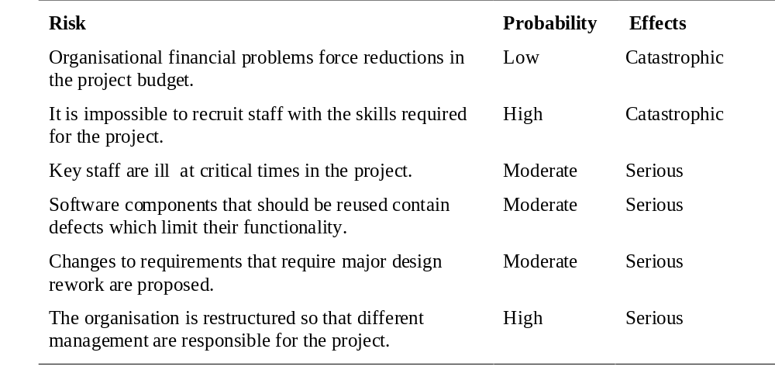
Risk analysis (i)

Slide 32
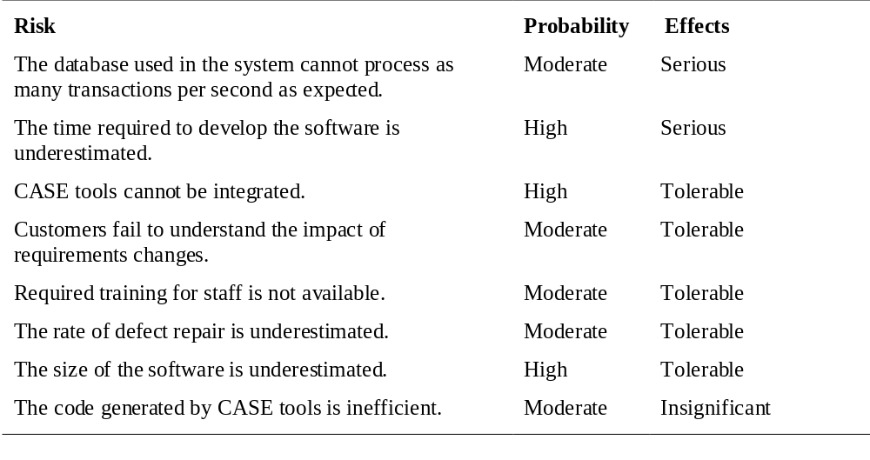
Risk analysis (ii)

Slide 33
Risk planning
Consider each risk and develop a strategy to manage that risk.
Avoidance strategies
  The probability that the risk will arise is reduced;
Minimisation strategies
  The impact of the risk on the project or product will be reduced;
Contingency plans
  If the risk arises, contingency plans are plans to deal with that risk;

Slide 34
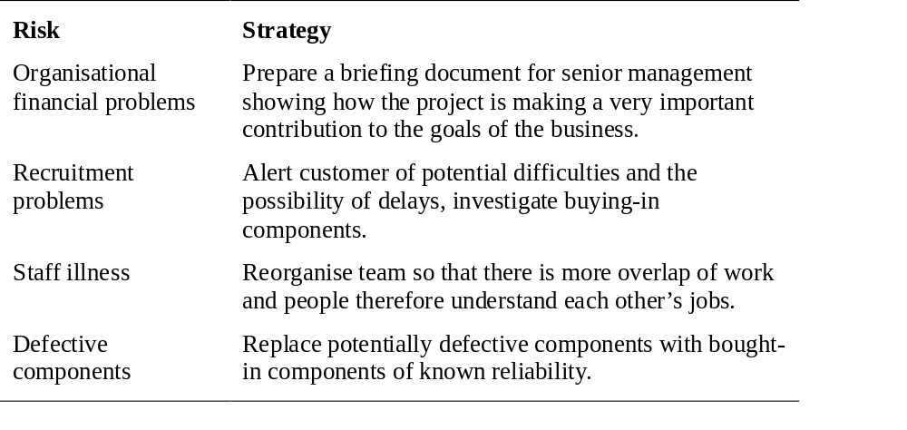
Risk management strategies (i)

Slide 35
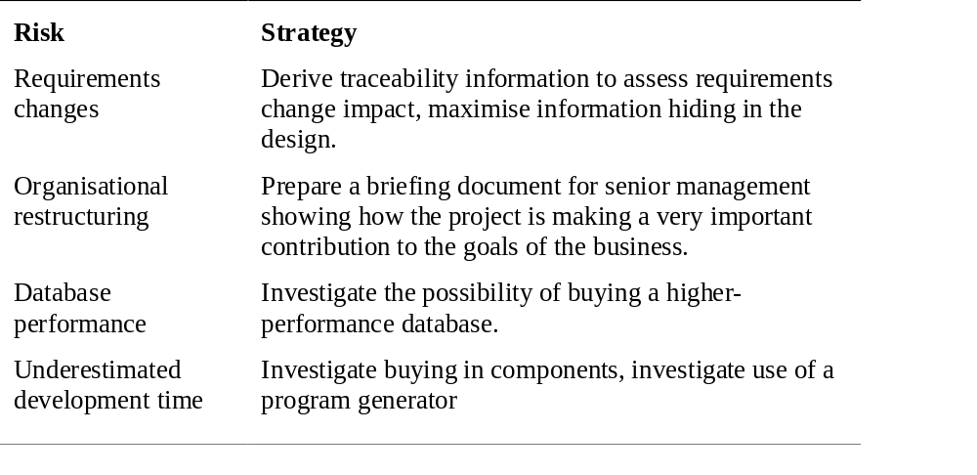
Risk management strategies (ii)

Slide 36
Risk monitoring
Assess each identified risks regularly to decide whether or not it is becoming less or more probable.
Also assess whether the effects of the risk have changed.
Each key risk should be discussed at management progress meetings.

Slide 37
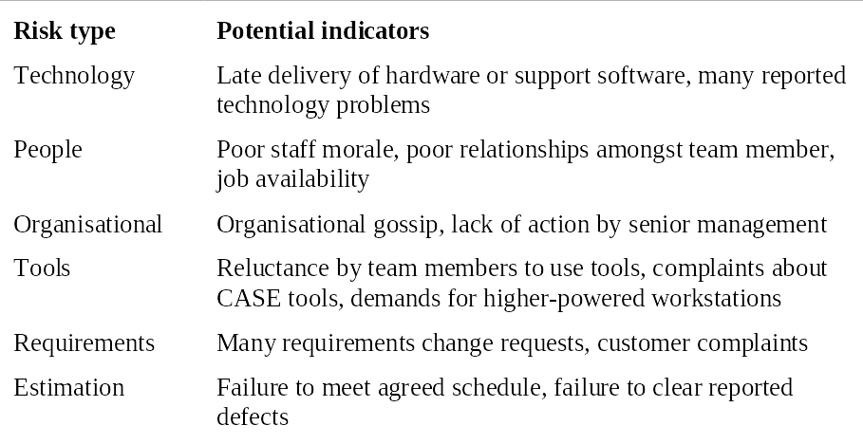
Risk indicators

Slide 38
System reliability specification
Hardware reliability
  What is the probability of a hardware component failing and how long does it take to repair that component?
Software reliability
  How likely is it that a software component will produce an incorrect output. Software failures are different from hardware failures in that software does not wear out. It can continue in operation even after an incorrect result has been produced.
Operator reliability
  How likely is it that the operator of a system will make an error?

Slide 39
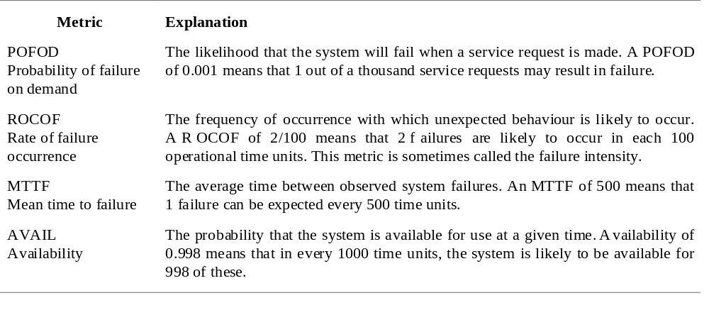
Reliability metrics

Slide 40
Probability of failure on demand
This is the probability that the system will fail when a service request is made. Useful when demands for service are intermittent and relatively infrequent.
Appropriate for protection systems where services are demanded occasionally and where there are serious consequence if the service is not delivered.
Relevant for many safety-critical systems with exception management components
  Emergency shutdown system in a chemical plant.

Slide 41
Rate of fault occurrence (ROCOF)
Reflects the rate of occurrence of failure in the system.
ROCOF of 0.002 means 2 failures are likely in each 1000 operational time units e.g. 2 failures per 1000 hours of operation.
Relevant for operating systems, transaction processing systems where the system has to process a large number of similar requests that are relatively frequent
  Credit card processing system, airline booking system.

Slide 42
Mean time to failure
Measure of the time between observed failures of the system. Is the reciprocal of ROCOF for stable systems.
MTTF of 500 means that the mean time between failures is 500 time units.
Relevant for systems with long transactions i.e. where system processing takes a long time. MTTF should be longer than transaction length
  Computer-aided design systems where a designer will work on a design for several hours, word processor systems.

Slide 43
Availability
Measure of the fraction of the time that the system is available for use.
Takes repair and restart time into account
Availability of 0.998 means software is available for 998 out of 1000 time units.
Relevant for non-stop, continuously running systems
  telephone switching systems, railway signalling systems.

Slide 44
Non-functional requirements spec.
Reliability measurements do NOT take the consequences of failure into account.
Transient faults may have no real consequences but other faults may cause data loss or corruption and loss of system service.
May be necessary to identify different failure classes and use different metrics for each of these. The reliability specification must be structured.

Slide 45
Failure consequences
When specifying reliability, it is not just the number of system failures that matter but the consequences of these failures.
Failures that have serious consequences are clearly more damaging than those where repair and recovery is straightforward.
In some cases, therefore, different reliability specifications for different types of failure may be defined.

Slide 46
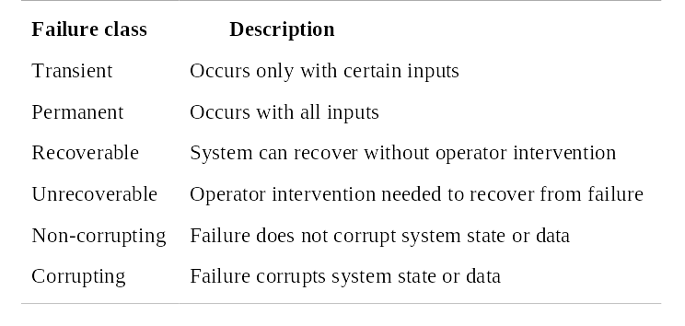
Failure classification

Slide 47
Steps to a reliability specification
For each sub-system, analyse the consequences of possible system failures.
From the system failure analysis, partition failures into appropriate classes.
For each failure class identified, set out the reliability using an appropriate metric. Different metrics may be used for different reliability requirements.
Identify functional reliability requirements to reduce the chances of critical failures.

Slide 48
Bank auto-teller system
Each machine in a network is used 300 times a day
Bank has 1000 machines
Lifetime of software release is 2 years
Each machine handles about 200, 000 transactions
About 300, 000 database transactions in total per day

Slide 49
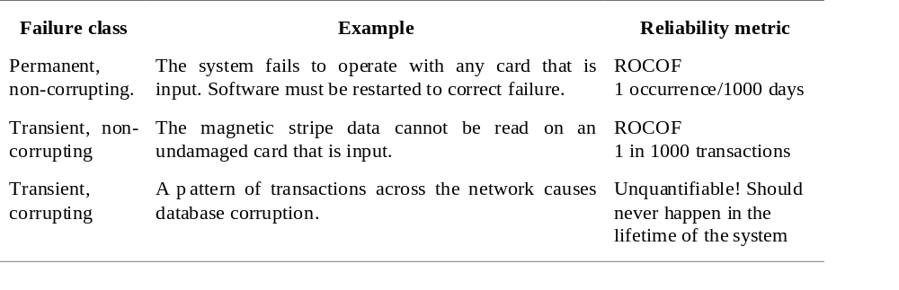
Reliability specification for an ATM

Slide 50
Specification validation
It is impossible to empirically validate very high reliability specifications.
No database corruptions means POFOD of less than 1 in 200 million.
If a transaction takes 1 second, then simulating one day’s transactions takes 3.5 days.
It would take longer than the system’s lifetime to test it for reliability.

Slide 51
Key points
Good project management is essential for project success.
The intangible nature of software causes problems for management.
Managers have diverse roles but their most significant activities are planning, estimating and scheduling.
Planning and estimating are iterative processes
which continue throughout the course of a
project.

Slide 52
Key points
A project milestone is a predictable state where a formal report of progress is presented to management.
Project scheduling involves preparing various graphical representations showing project activities, their durations and staffing.
Risk management is concerned with identifying risks which may affect the project and planning to ensure that these risks do not develop into major threats.

